Slide 1
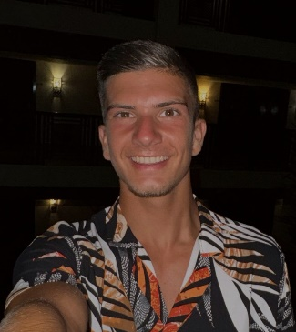
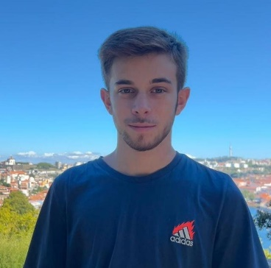

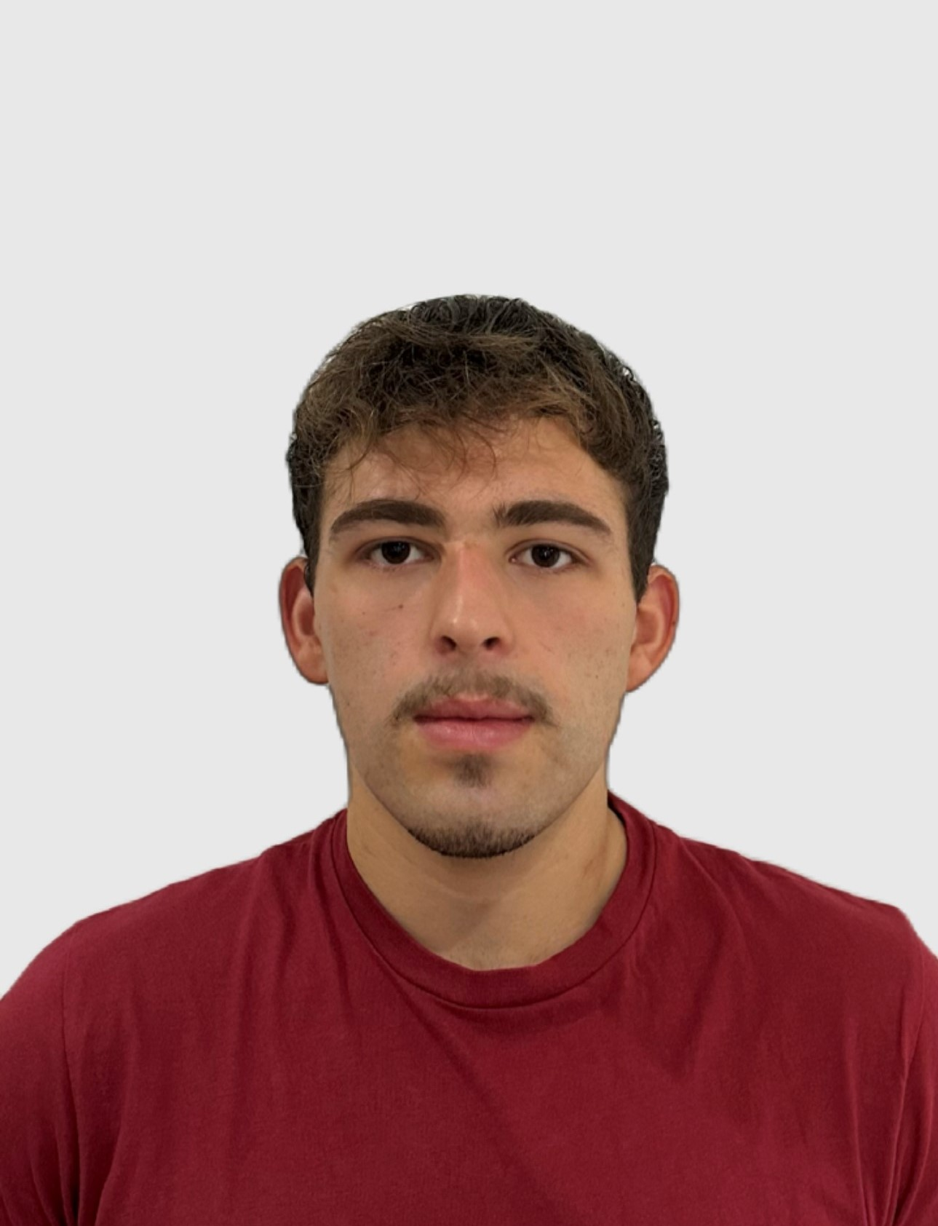
Class 2DC2DD Group 41 SPRINT 3
LAPR3 2024_2025
Group members:
Igor Coutinho (1230543) | Daniel Silva (1231046) | Rafael Barbosa (1230544) | David Vieira (1230487)

Slide 2
Sprint planning – Sprint 3
Planned Start Date: 25/11/2024 Real Start Date: 02/12/2024
Planned Finished Date: 05/01/2025 Real Finish Date: 05/01/2024
SPRINT BACKLOG
Number of stories | 29
Number of bugs | 0 (found so far)
Number of tasks | 89
Number of Management Tasks (Scrum) | 95
Number of team members | Planned: 4 Actual: 4
Total planned estimation vs execution | Planned hours: 201 Executed hours: 223

Slide 3
Sprint planning
Assignment US (as stated on project assignment) | Commited? (Yes / no according to team planning) | Todo | Doing | Testing | Done | Blocked
USBD 20 | Yes |  |  |  | x
USBD 21 | Yes |  |  |  | x
USBD 22 | Yes |  |  |  | x
USBD 23 | Yes |  |  |  | x​
USBD 24 | Yes |  |  |  | x​
USBD 25 | Yes |  |  |  | x​
USBD 26 | Yes |  |  |  | x​
USBD 27 | Yes |  |  |  | x​
USBD 28 | Yes |  |  |  | x​
USEI 17 | Yes |  |  |  | x​
USEI 18 | Yes |  |  |  | x​

Slide 4
Sprint planning
Assignment US (as stated on project assignment) | Commited? (Yes / no according to team planning) | Todo | Doing | Testing | Done | Blocked
USEI 19 | Yes |  |  |  | x
USEI 20 | Yes |  |  |  | x​
USEI 21 | Yes |  |  |  | x​
USEI 22 | Yes |  |  |  | x
USEI 23 | Yes |  |  |  | x​
USEI 24 | Yes |  |  |  | x​
USLP 06 | Yes |  |  |  | x​
USLP 07 | Yes |  |  |  | x​
USLP 08 | Yes |  |  |  | x
USAC 11 | Yes |  |  |  | x
USAC 12 | Yes |  |  |  | x

Slide 5
Sprint planning
Assignment US (as stated on project assignment) | Commited? (Yes / no according to team planning) | Todo | Doing | Testing | Done | Blocked
USAC 13 | Yes |  |  |  | x
USAC 14 | Yes |  |  |  | x
USAC 15 | Yes |  |  |  | x
USAC 16 | Yes |  |  |  | x
USAC 17 | Yes |  |  |  | x
USAC 18 | Yes |  |  |  | x
USFA 03 | Yes |  |  |  | x

Slide 6
Work by team member

Slide 7
Work by team member (All Sprints)
Notes:
Se compilaram o registo de horas colocar as horas de trabalho, caso contrario utilizar o numero de tarefas ou algo que reflita a distribuição de trabalho.

Slide 8
Work by type

Slide 9
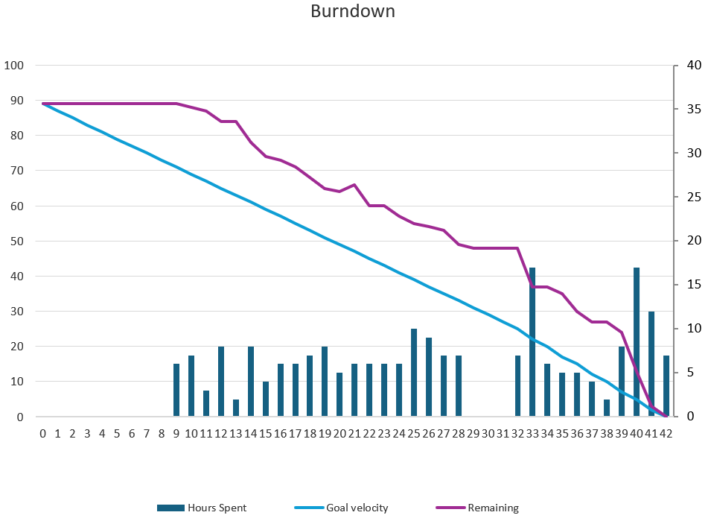
Sprint Burndown Chart

Slide 10
Issues / Assumptions / unanswered questions
Description | Responsible | Date / sprint | Related issue / item in Git
The start of sprint 3 proved to be late due to the fact that the statement had not yet been made available, a situation is reflected in the Burndown Chart as in the first few days the line of reality is not at all aligned with the ideal. | Whole Group | Sprint 3
We had problems with the Arduino made available to our group as it had defects, and this intensified due to the fact that the technical office and teachers took several days to respond to our attempts to contact them. | Whole Group | Sprint 3 | All USAC and USFA03

Slide 11
Daily Meetings
Date | Place / duration | Daniel | David | Igor | Rafael
02/12/2024 | 10min, ISEP | x | x | x | x
04/12/2024 | 10min, ISEP | x | x | x | x
06/12/2024 | 15min, ISEP | x | x | x | x
09/12/2024 | 10min, ISEP | x | x | x | x
11/12/2024 | 15min, ISEP | x | x | x | x
13/12/2024 | 10min, ISEP | x | x | x | x
16/12/2024 | 20 min, ISEP | x | x | x | x
18/12/2024 | 15 min, ISEP | x | x | x | x
20/12/2024 | 10 min, ISEP | x | x | x | x
22/12/2024 | 15 min, Discord | x | x | x | x
27/12/2024 | 15 min, Discord | x | x | x | x
29/12/2024 | 15 min, Discord | x | x | x | x
02/01/2025 | 10 min, Discord | x | x | x | x
03/01/2025 | 15 min, Discord | x | x | x | x
04/01/2025 | 20 min, Discord | x | x | x | x

Slide 12
LLM assessment (Copylot)
 | With daily meeting records | With daily meeting records, status report and project assignment
LLM Evaluation (0-10): | 9 | 9 | Team Evaluation (0-10): | 9
LLM team and project assessment summary output: | The team demonstrated consistent progress throughout the Sprint, as evidenced by their detailed daily meetings, status reports, and the completion of various user stories. Each member contributed significantly to the project, tackling complex tasks such as implementing PERT-CPM graphs, developing algorithms for detecting circular dependencies, and working on Arduino assembly. Despite facing challenges, particularly with the Arduino device, the team maintained effective communication and collaboration, ensuring that issues were addressed promptly. The status reports highlight individual contributions and the ability to adapt and support each other, along with their dedication to meeting project requirements, reflecting a high level of performance. Overall, I would rate the team's performance as 9 out of 10.

Slide 13
Comments on LLM Evaluation: | We consider the output to be reasonably in line with what was developed during the sprint.​ | Team valuation on LLM comments (Very Good, Good, Medium, Bad):: | Medium/Good
 | LLM improvement ideas
Ask LLM for 4 improvements ideas: | 1. Enhanced Task Prioritization and Planning: Improve the prioritization of tasks and planning to ensure that critical tasks are identified and addressed early in the Sprint. This can help in managing time more effectively and reducing last-minute rushes. 2. Better Hardware Integration and Testing: Allocate more time and resources for hardware integration and testing, especially for components like Arduino. This can help in identifying and resolving hardware issues earlier in the development process. 3. Increased Collaboration and Knowledge Sharing: Foster a culture of increased collaboration and knowledge sharing among team members. Regular knowledge-sharing sessions can help team members understand different aspects of the project better and reduce dependency on specific individuals. 4. Improved Documentation and Reporting: Enhance the quality and detail of documentation and status reports. This can help in better tracking of progress, identifying potential issues early, and ensuring that all team members are on the same page regarding project requirements and progress.
Which ideas would you implement? (1, 2, 3, 4?) | 1, 2, 4

Slide 14
LLM performance assessment
Include here as attachment a file with the input and output prompt

Slide 15
Final Sprint Retrospective (FLAP) Date: 06/01/2025
Future considerations:
Investing more time in the initial planning of the project to avoid rework and minimize unforeseen issues.
Improving time management, both individually and as a team.
Lessons Learned:
The importance of clear communication among team members to avoid misunderstandings.
Having an efficient version control system (e.g., Git) was essential for organizing the code and avoiding conflicts.
Dividing tasks based on each member’s skills helped increase productivity. We learned that testing the code frequently is crucial to avoid issues piling up in the final phase.
Problem Areas:
Time management: Some tasks took longer than expected, delaying other parts of the project.
Component integration: There were difficulties integrating different parts of the system developed by various team members.
Work distribution: At times, the workload was not evenly distributed among all team members.
Accomplishments:
We successfully completed all the main features within the stipulated deadline.
The project was developed with a solid structure and followed good programming practices.
We learned to work more collaboratively as a team, even when facing challenges.

Slide 16

Overall Final Project Mood:
Independently on the team performance, what's the final Team feeling (0-10): 9
Justification: Even with all the bad situations that happened to us during this last Sprint, our group always remained calm and was always very determined to resolve each aspect, no matter how complicated it was. We have always worked as a team and dialogue and help were fundamental to achieving the success we wanted.

Slide 17


